Slide 1
Homework 1
TESLA Stock Value Change
Saeideh Khadem

Slide 2
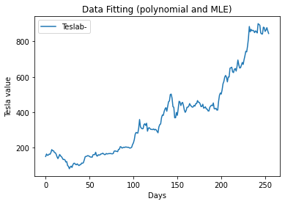
Data visualization

Slide 3
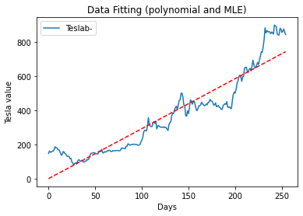
Linear regression
Y=ax+b
[a b]=[2.92349241 2.20630808]
Linear regression formula
Y= 2.92x+2.20

Slide 4
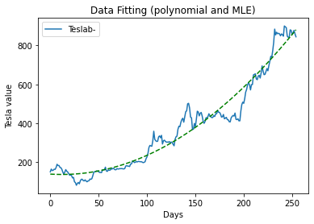
Second order graph fitting
Y=ax²+bx+c
[a b c]=[ 1.2e-02 -3.03e-01 1.38e+02]
Y= 0.012x² – 0.3x +0.013

Slide 5
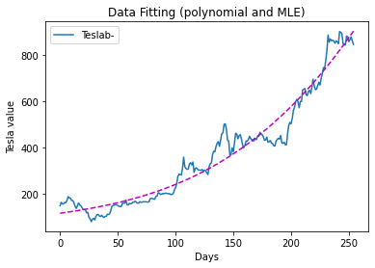
Third order graph fitting
Y=ax³ +bx²+cx+d
[a b c d]=[2.62-05 2.7e-03 7.1e-01 1.1e+02]
Y= 2.62e-05 x³ +
2.7e-03 x²+
7.1x+
1.1e+02

Slide 6
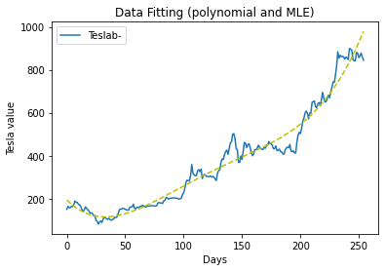
Fourth order graph fitting
Y=ax⁴ +bx³ +cx²+dx+e
[a b c d]=[1.3e-06 -6.4e-04 1.1e-01 -5.4 1.9e+02]
Y= 1.3e-06 x⁴ -
6.4e-04 x³+
1.1e-01 x² –
5.4 x +
1.9e+02

Slide 7
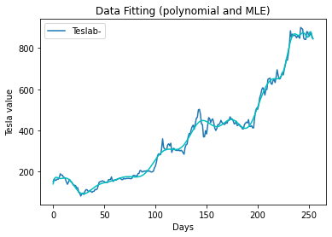
Hundred order graph fitting
As it is seen, the higher the order of the estimator is, the closer the prediction is to the real data

Slide 8
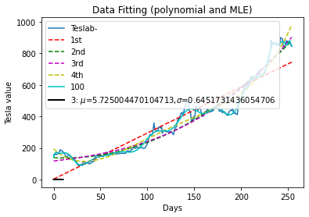
All curve in one plot

Slide 9
